Slide 1
1) Retention of high performing employees 2) prediction of employees at risk of leaving
Insights designed to improve:
Peter Lambert

Slide 2
What defines a high performing leaver?
age
Job satisfaction
Leavers are on average almost 4 years younger
Leavers score almost 0.5 points less on job satisfaction
distance
Leavers live over 3km further away
Notes:
The top performing employees who have left have the following significant characteristics versus their high performing colleagues on average:
Almost 4 years younger
They live almost 3km further away
Their job satisfaction is almost 0.5 points lower
They are 1/3 less likely to have filed a complaint
They have 4 less total working years
They have 2 less years at the company
Monthly income is around 60% of colleagues who stay

Slide 3
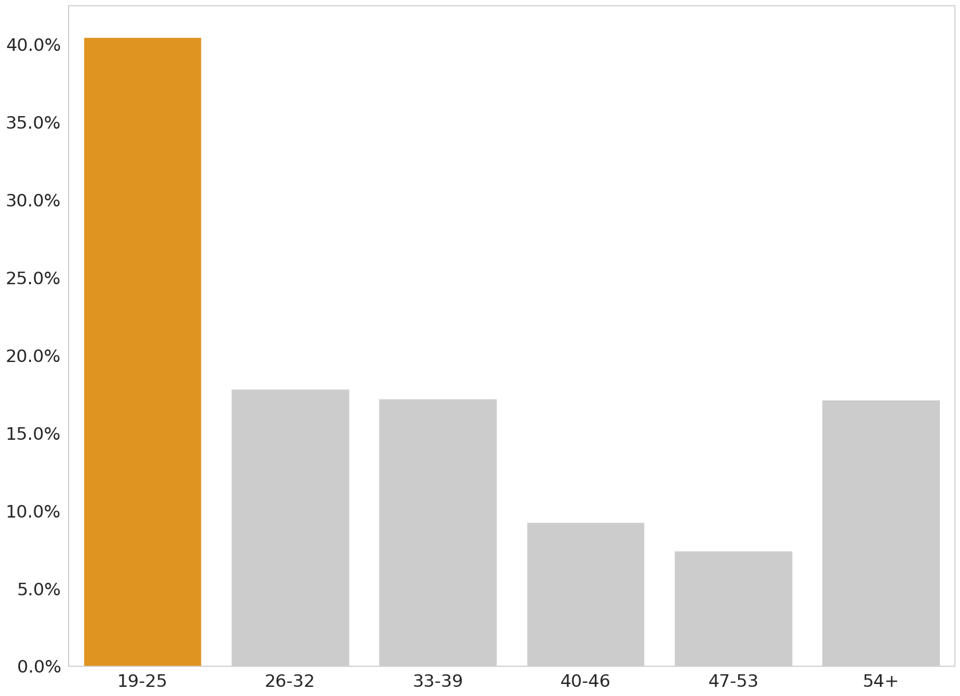
Percentage of high performing leavers by age category
Leave percentage
Age categories

Slide 4
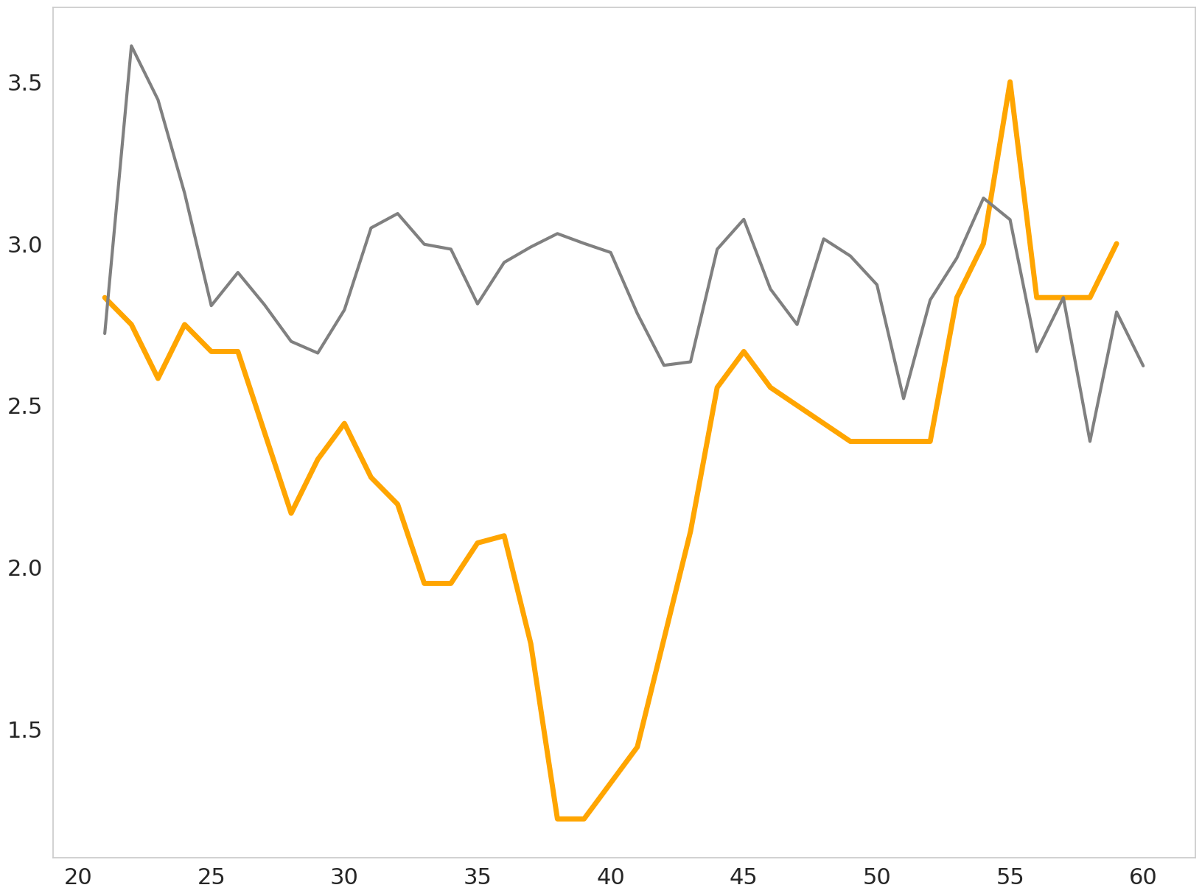
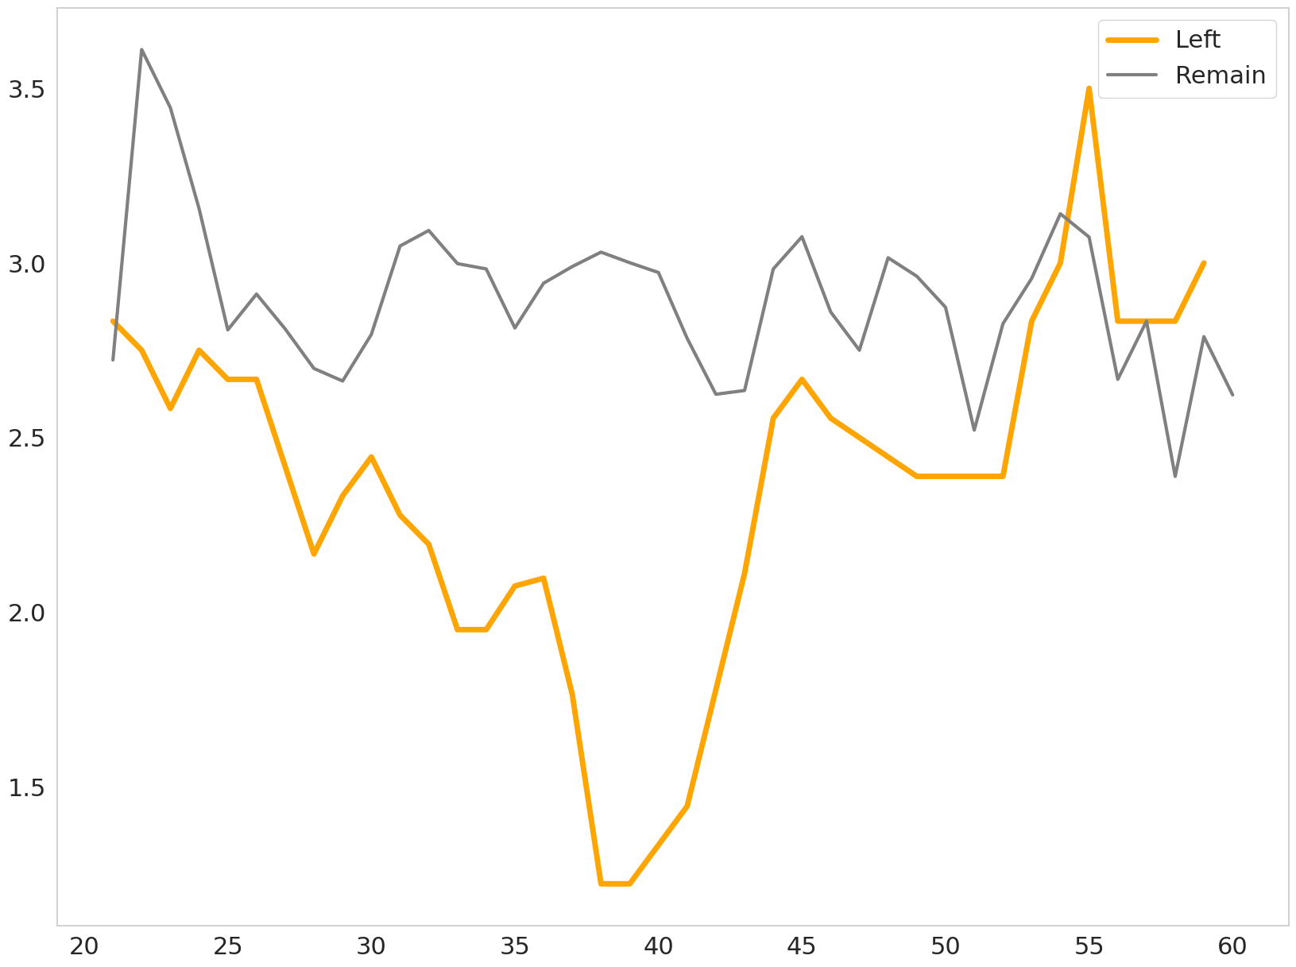
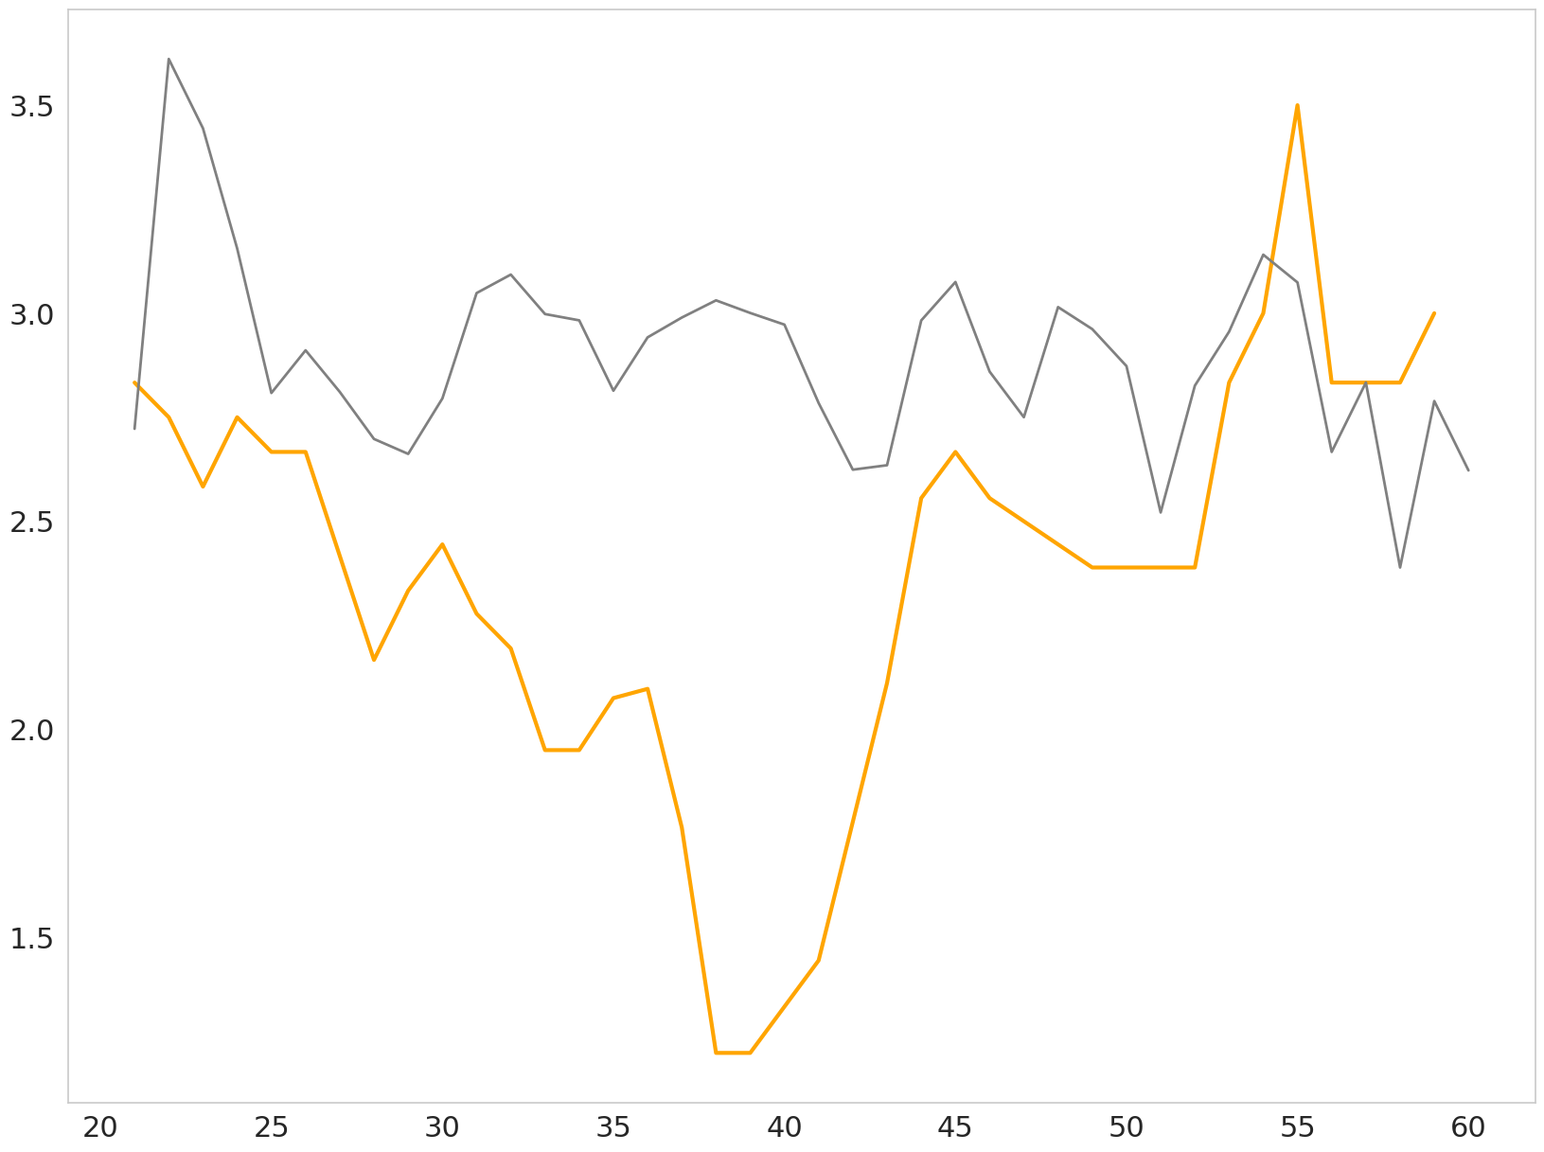
High performing Job satisfaction through the years
Job Satisfaction
Age

Slide 5
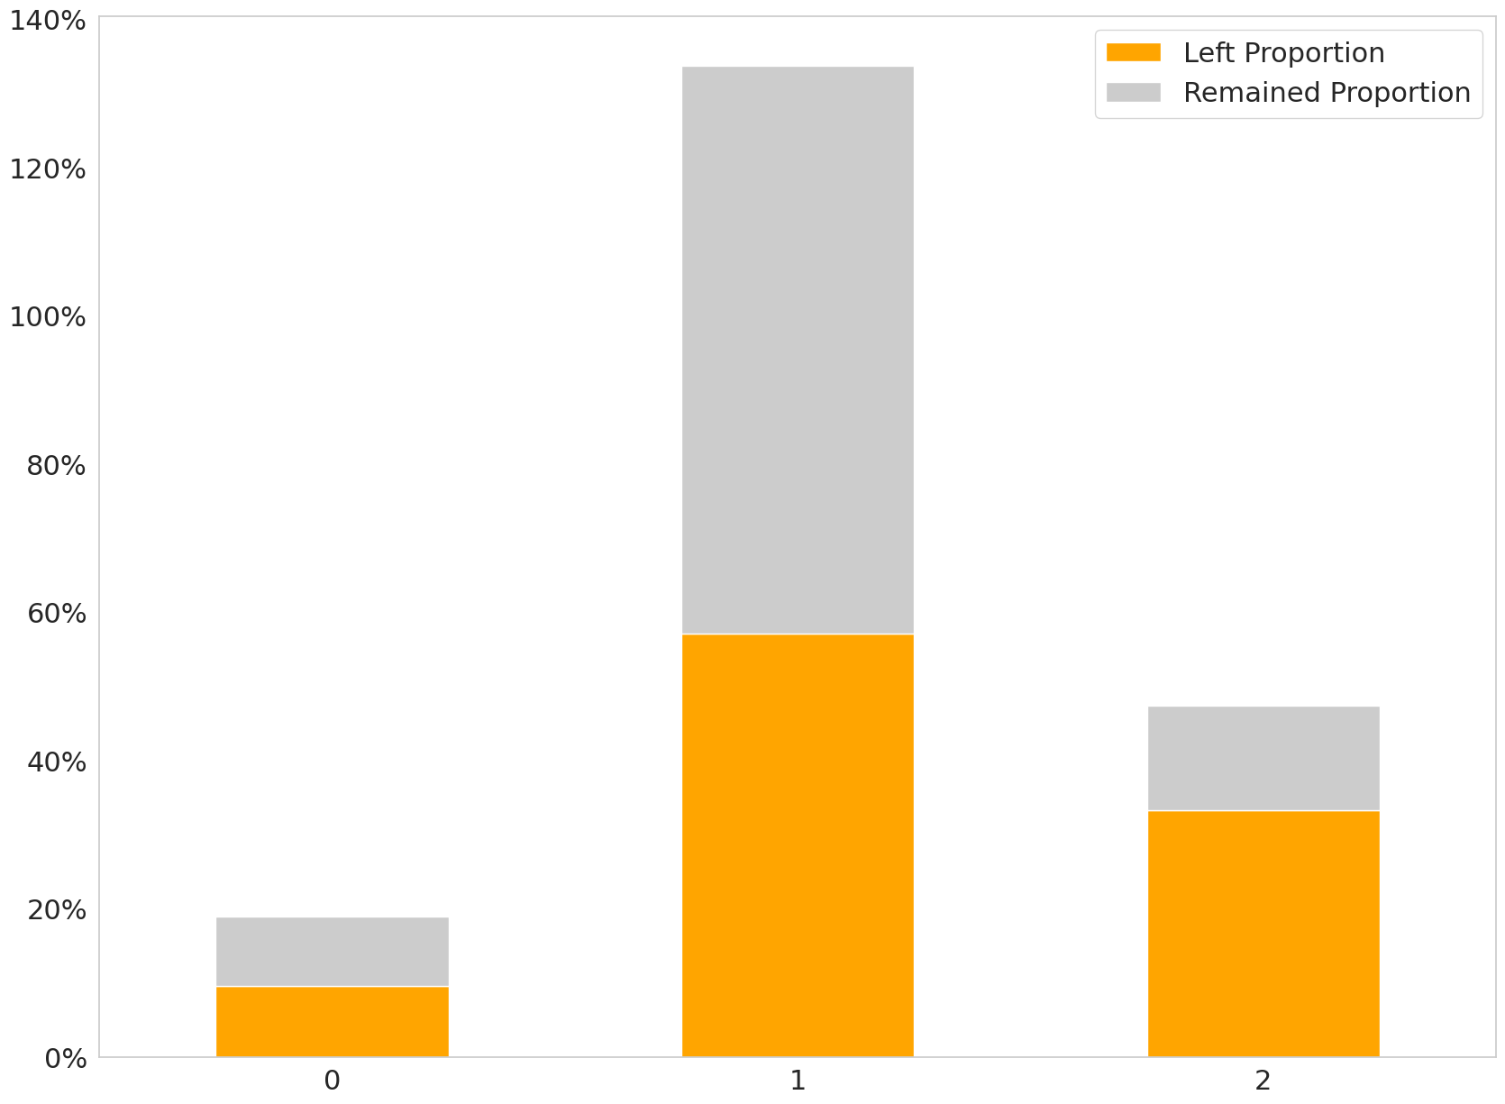
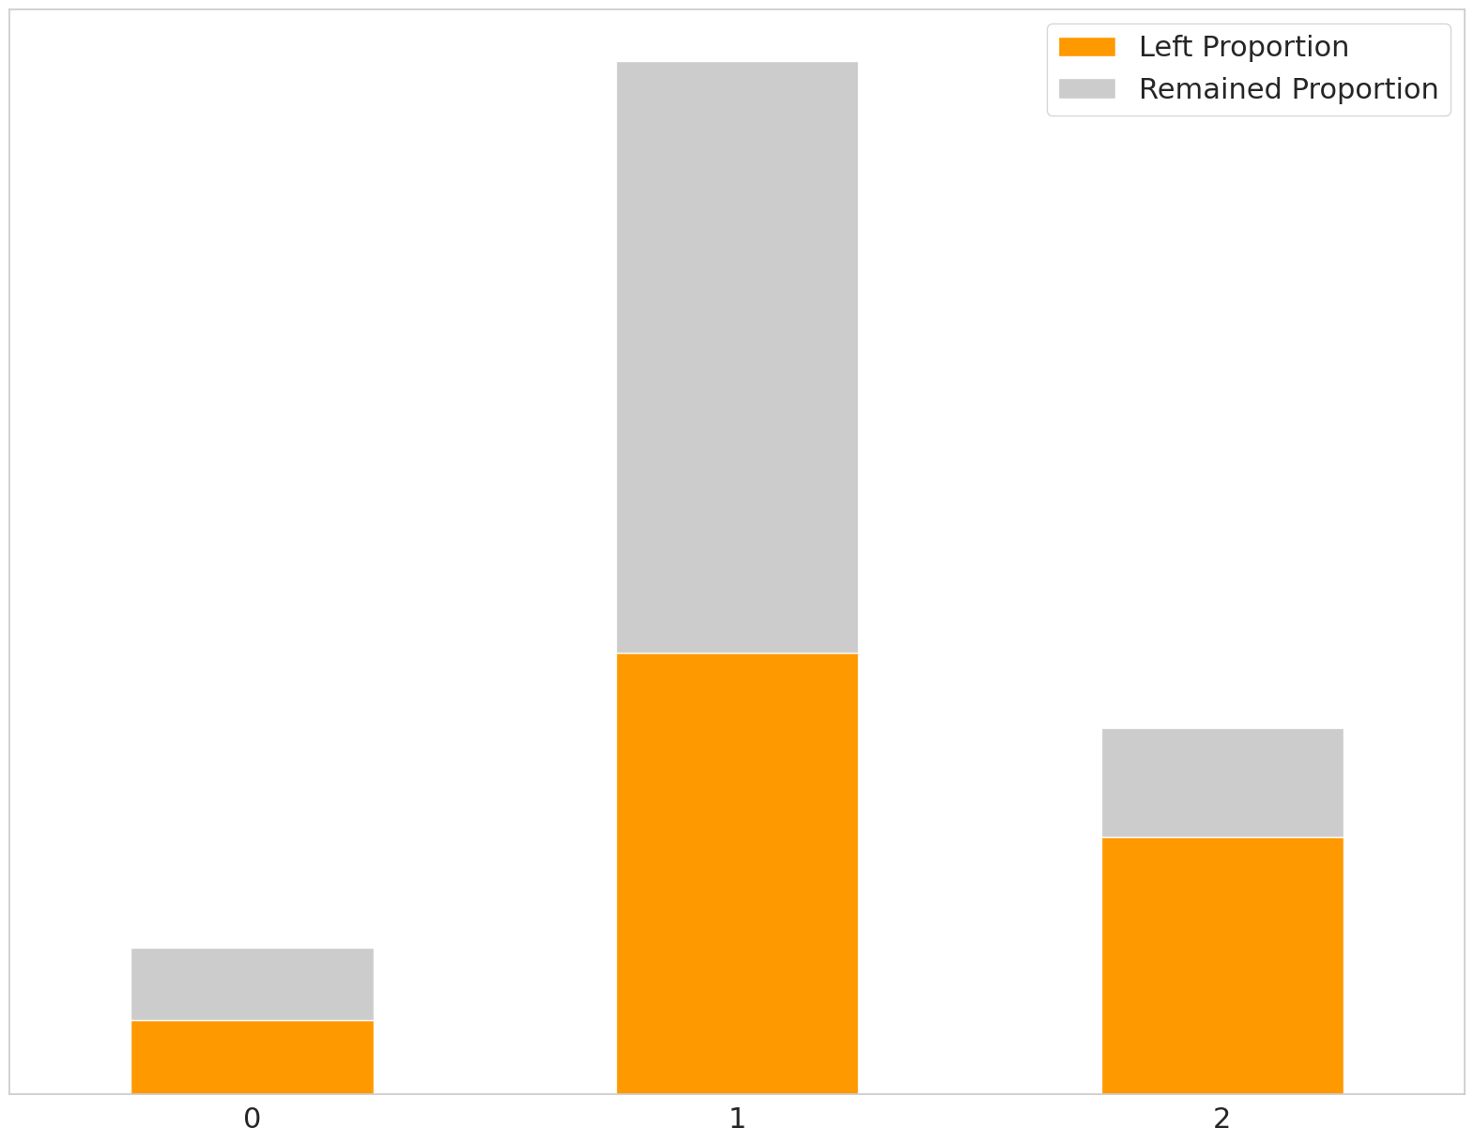
Business travel required by High performing employees
Cumulative Leave percentage
Business travel amount
Notes:
Include some online stats here to back up ideas

Slide 6
WHO IS AT Risk? MODELLING LEAVERS

Slide 7
Classification model feature selection
1) DISTANCE FROM HOME
2) JOB SATISFACTION
Strongest NEGATIVE impact. Employees are less engaged with the company when they are further away.
Strongest POSITIVE impact. Happy employees are less likely to leave.
3) BUSINESS TRAVEL
4) AGE
High NEGATIVE impact. Employees could feel less connected to the company when travel is a requirement of their job.
Medium POSITIVE impact. Younger employees are more likely to explore the job market and feel unfulfilled.
5) YEARS AT COMPANY
6) MONTHLY INCOME
Medium POSITIVE impact. Employees feel more loyal to the company the longer they have worked there.
Low POSITIVE impact. Employees feel valued for their efforts when their pay is increased to match their performance level.

Slide 8
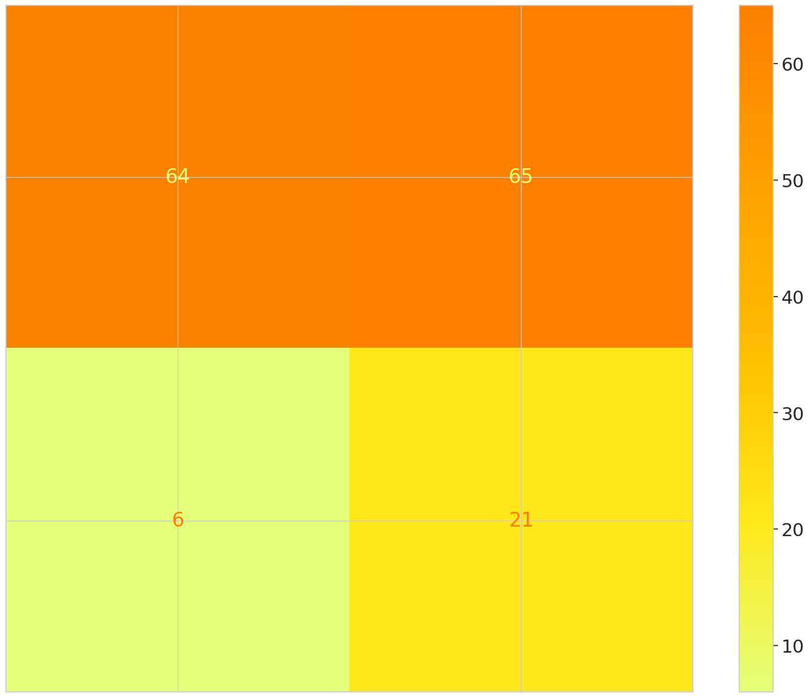
Classification model employee classification
AT RISK
REMAIN
TRUE LABEL
LEFT
REMAIN
LEFT
PREDICTED LABEL

Slide 9
Objective brief
Operational
tactical
strategic
Why are people leaving right now?
What can we do about it?
How can we predict who will leave? What changes
do we need to make to our operating model?
How can we retain more high
performing employees?

Slide 10
Operational Why are people leaving right now? What can we do about it?
1) DISTANCE FROM HOME
2) JOB SATISFACTION
3) BUSINESS TRAVEL
4) AGE
5) YEARS AT COMPANY
6) MONTHLY INCOME
AGE/ YEARS AT COMPANY
Focus on improving the onboarding process for young employees to improve integration from the start of their roles.
Mentorship programs to engage across the age groups.
DISTANCE FROM HOME/ BUSINESS TRAVEL
Business travel and distance from home makes employees less connected to the company.
Improve offerings of social events with the company to promote a fun, engaging workplace.
MONTHLY INCOME
Understand where employee performance has not converted into increased monthly income, highlighting employees who could feel currently disillusioned.

Slide 11
tactical How can we predict who will leave? What changes do we need to make to our operating model?
Use our classification model to understand when an employee has been categorized as above a certain threshold for leaving.
Consistently update the model with new data and improvements
Make sure regular job satisfaction and performance rveiews are updated, using the model to highlight employees who are moving into the high risk category
Perform employee interviews on current and ex employees to explore validation of the model’s performance

Slide 12
Strategic How can we retain more high performing employees?
DO EMPLOYEES FEEL VALUES AND REWARDED FOR THEIR HIGH PERFORMANCE? Loyalty schemes for high performing users based on how long they stay with the company. Create internal recognition programmes to improve appreciation and recognition. ARE THE RIGHT YOUNG PEOPLE BEING HIRED AND MANAGED EFFECTIVELY? Look to improve hiring strategies and feedback. Increase focus on hired which prioritise culture fits and coworker reccomended hires. Ensure that career development plans are being promoted from an early stage.
DO EMPLOYEES FEEL CONNECTED AND ENGAGED WITH THE COMPANY? Strive to create supportive work environments by providing proper training and development opportunities, led from direct management. Share schemes are a good method of helping employees feel connected with the performance of the company.

Slide 13

THANK YOU
Peter Lambert

